Slide 1

ENVIRONEMT SCIENCE, WASTE AND DISASTER MANAGEMENT
Dr. Akriti
Assistant Professor
Department Of Civil Engineering
Chandigarh University
Gharuan, Mohali, Punjab
Renewable & Non Renewable Resources
DISCOVER . LEARN . EMPOWER

Slide 2
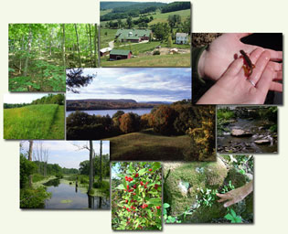
RENEWABLE & NON RENEWABLE RESOURCES
Course Outcome
CO Number | Title
CO1 | Understand different dimensions of environmental studies; problems related to environmental degradation & the remedial steps taken to address them.
CO2 | Understand the different types of disasters that occur in nature consequently learning to develop preparedness and remedial techniques.
CO3 | Understand the diverse problems associated with solid waste, as well as waste segregation and effective management techniques.
CO4 | Critically analyzing the roles and identities as citizens, consumers, and environmental actors in a complex, interconnected world.
CO5 | Create awareness about environmental issues and carry out outreach activities.

Slide 3
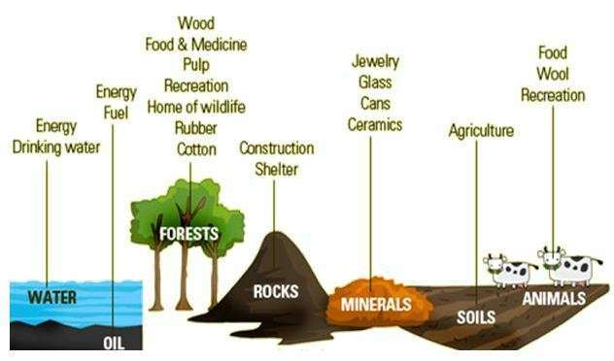
NATURAL RESORCCES
Natural resources are naturally occurring substances that are considered valuable in their relatively unmodified (natural) form.
A natural resource’s value rests in the amount of the material available and the demand for it.
To meet our “needs” and “wants” we use resources in many different ways.

Slide 4
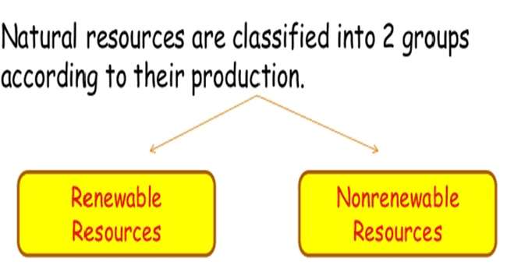
TYPES OF NATURAL RESOURCES
BASED UPON THEIR PRODUCTION

Slide 5
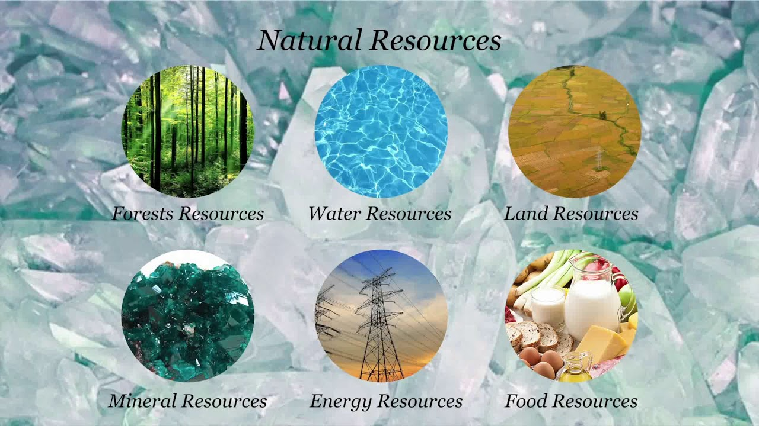
TYPES OF NATURAL RESOURCES
BASED ON THEIR UTILITY:
Land Resources
Energy Resources
Mineral Resources
Food Resources
Water Resources
Forest Resources

Slide 6
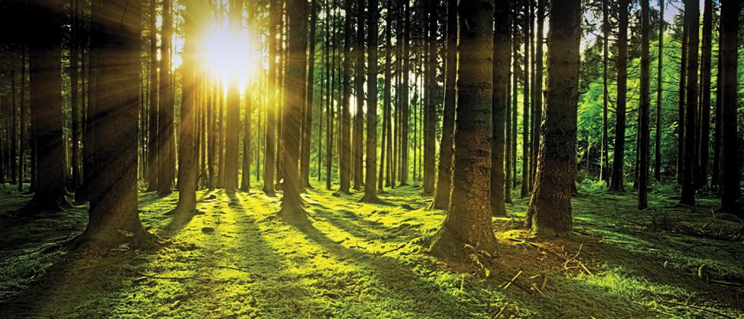
FOREST RESOURCES
Major renewable natural resources.
Biotic community mainly consists of trees, shrubs or other vegetation.
About one third of the total land area of the earth is covered by forests.

Slide 7
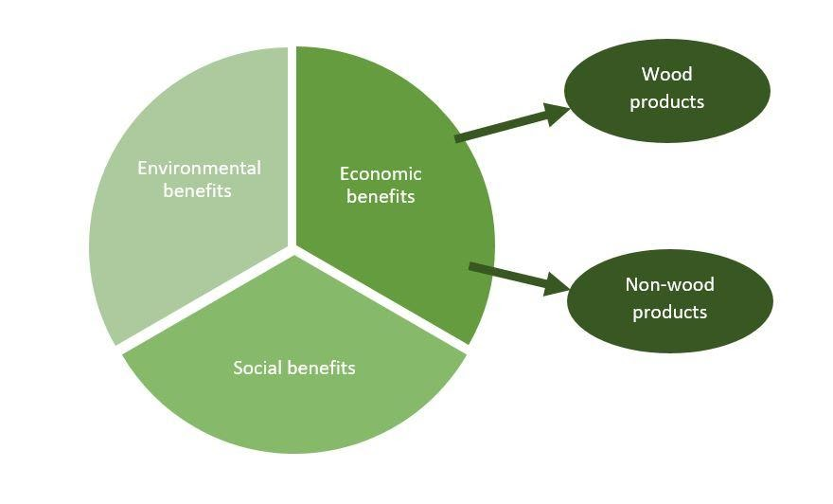
ADVANTAGES OF FORESTS
Shelter
Soil conservation
Reducing global warming
Control Flood
Aesthetic importance
Supply of Raw Materials

Slide 8
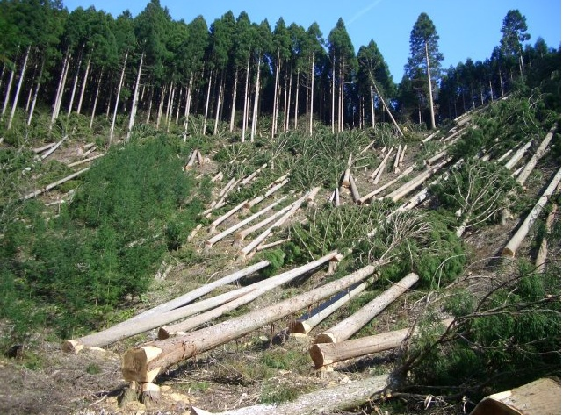
PROBLEM- DEFORESTATION
A continuous loss of the forest area resulting from more cutting of trees than planting

Slide 9
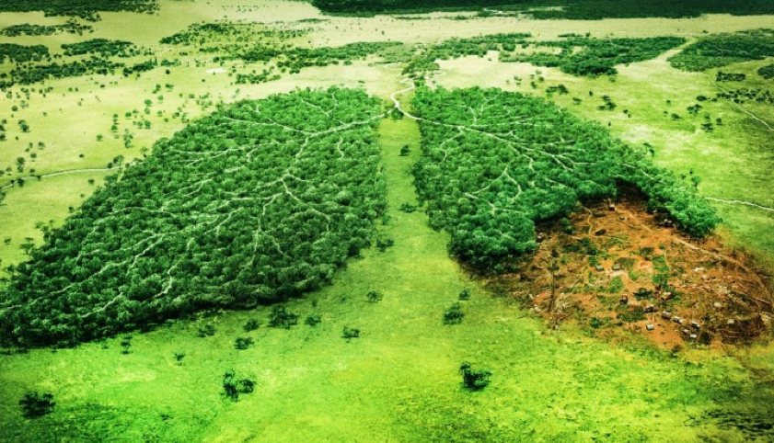
CAUSES OF DEFORESTATION
OVER POPULATION
DEMAND OF WOOD FOR INDUSTRIES
MINING OPERATION
DAMS AND HYDRO-ELECTRIC OPERATIONS
FIRES

Slide 10
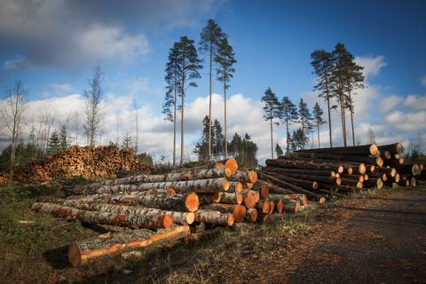
IMPACTS OF DEFORESTATION
SOIL EROSION
FLOODS
EXTINCTION OF SPECIES
GLOBAL WARMING
DECREASED BENEFITS

Slide 11

CONSERVATION OF FORESTS
Regulated and Planned Cutting of Trees
Control over Forest Fires
Reforestation and Afforestation
Proper Utilization of Forest and Forests Products
Role of Government in Forest Conservation

Slide 12

WATER RESORCES
At global scale about 71% of the earth’s surface is covered with water.
Water keeps on cycling endlessly in the environment through hydrological cycle.
Solar energy drives the hydrological cycle through transpiration from the plants and evaporation from the water bodies which return back through rainfall and snow.

Slide 13
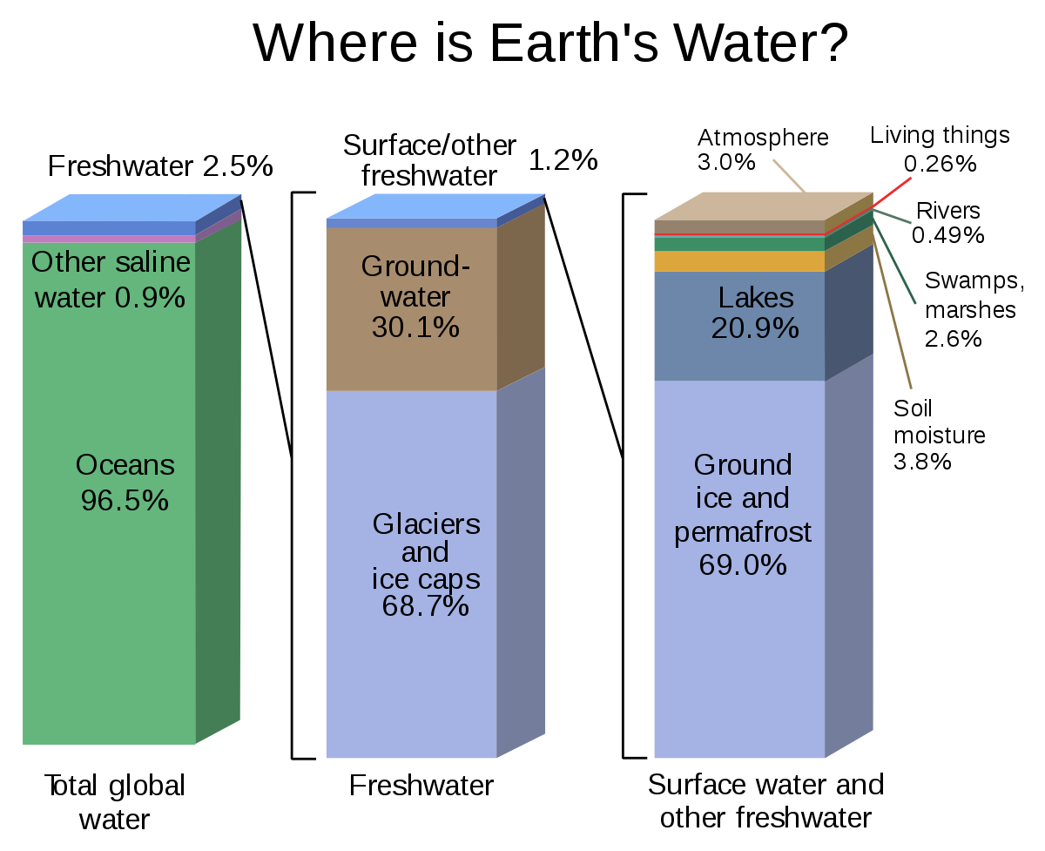
WATER RESORCES

Slide 14
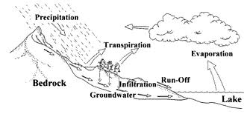
WATER RESORCES
Hydrological Cycle

Slide 15

IMPORTANCE OF WATER
Have High specific heat capacity
Used as a coolant
Used as an excellent solvent
Used for irrigation, which is very essential for the success of agriculture.
Water is used for the generation of hydroelectric power.
Water resources also provide navigation facilities.
Used for industrial purposes.

Slide 16
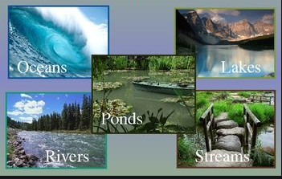
SOURCES OF WATER
Surface water is water on the surface of the planet such as in a stream, river, lake, wetland, or ocean.
Groundwater is water that exists in the pore spaces and fractures in rock and sediment beneath the Earth's surface. It originates as rainfall or snow, and then moves through the soil into the Groundwater system, where it eventually makes its way back to surface streams, lakes, or oceans.

Slide 17
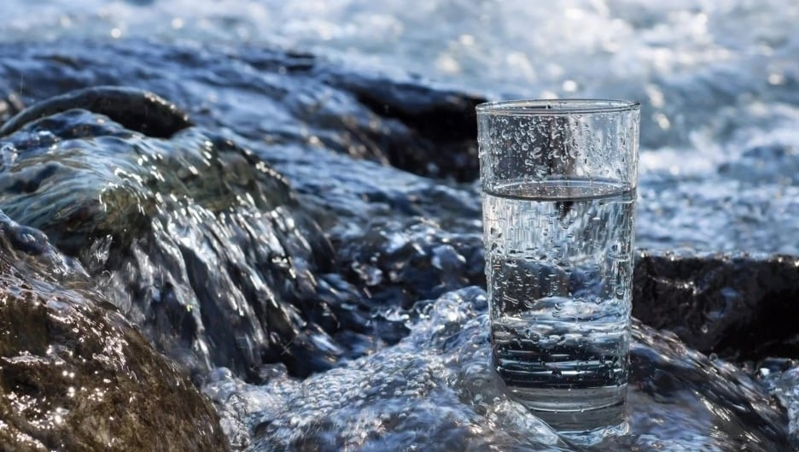
OVER UTILIZATION OF WATER RESOURCES
Population explosion, industrial growth, and expansion of agriculture have increased the demand for water manifold.
Overuse of groundwater has resulted in rapid depletion of groundwater leading to lowering of the water table and drying of wells.
Reasons of overutilization-
Increasing water demand
Increase in population in cities
Water utilization in industrial activities
Water in agriculture
Careless attitude
Consequences of overutilization
Lowering the water table
Salinity problems

Slide 18

CONSERVATION OF WATER RESOURCES
Prevention of runoff losses
Reduction of irrigation losses
Prevention of wastage of water
Re-use of water
Rain water harvesting

Slide 19
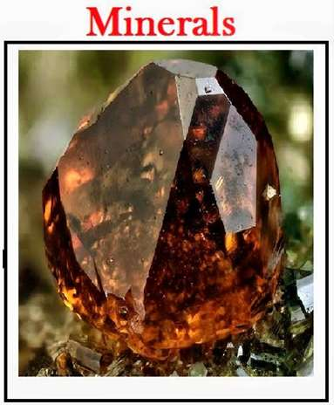
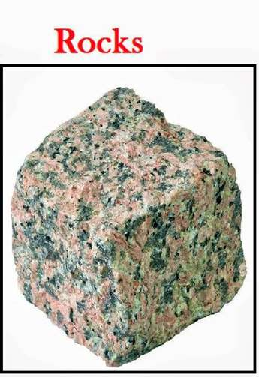
MINERAL RESOURCES
Rocks are naturally formed, consolidated material composed of grains of one or more minerals.
An ore is a mineral or combination of minerals from which a useful substance, such as a metal, can be extracted and used to manufacture a useful product.
Minerals are naturally occurring inorganic, crystalline solids having a definite chemical composition and characteristic physical properties.

Slide 20
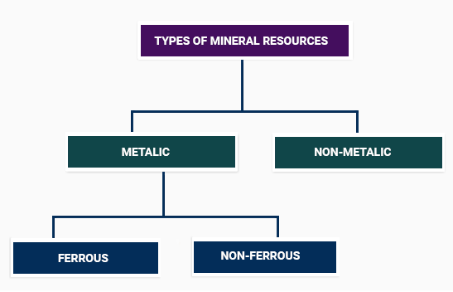
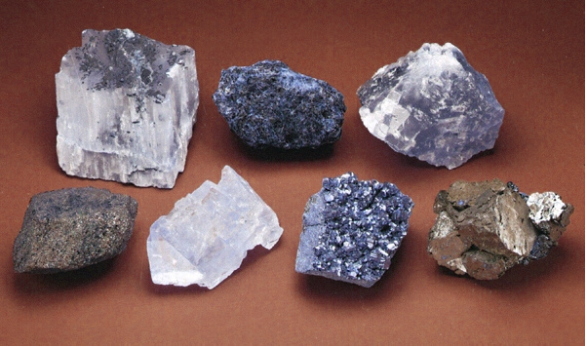
TYPES OF MINERAL RESOURCES

Slide 21
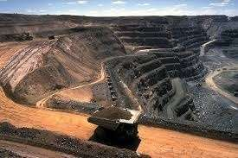
MINING
Mining is the extraction of valuable minerals or other geological materials from the earth.
The Mining industry in India is a major economic activity which contributes significantly to the economy of India.

Slide 22
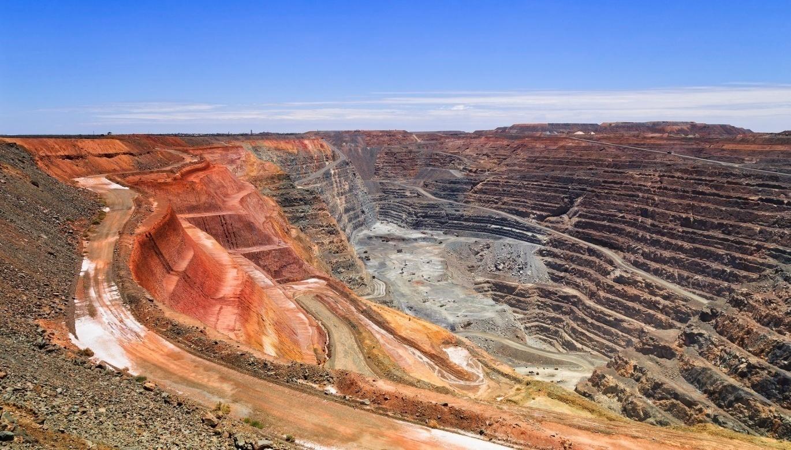
IMAPCT OF MINING
Deforestation and defacing of landscape
Subsidence of land
Surface water pollution
Groundwater pollution
Acid mine drainage
Air Pollution
Effect on biodiversity
Health hazards for workers
Waste of land

Slide 23
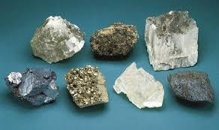
CONSERVATION OF MINERAL RESOURCES
Replacement minerals for use in place of scarce minerals which are in short supply and are going to be depleted soon.
Avoid over-exploitation of mineral resources.
Reuse and recycle minerals.
Create social awareness regarding conservation of minerals.
Selection and adoption of suitable methodology of mining which will have negligible effect on environment.

Slide 24
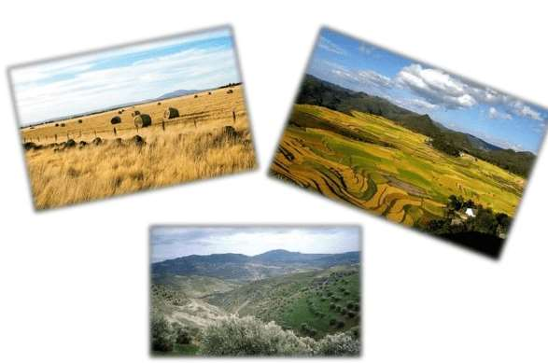
LAND RESOURCES
Land is an essential natural resource, both for the survival and prosperity of humanity, and for the maintenance of all terrestrial ecosystems.
People have become progressively more expert in exploiting land resources for their own ends. The limits on these resources are finite while human demands on them are not.
Increased demand, or pressure on land resources, shows up as declining crop production, degradation of land quality and quantity, and competition for land.

Slide 25
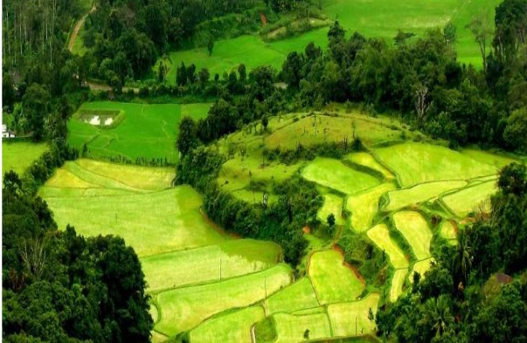
IMPORTANCE
Preserves terrestrial biodiversity and genetic pool.
Regulates water and carbon cycles.
Store house of resources like groundwater, minerals, and fossil fuels.
Forms the basis of human settlements.
Top soil horizon supports plant growth.

Slide 26
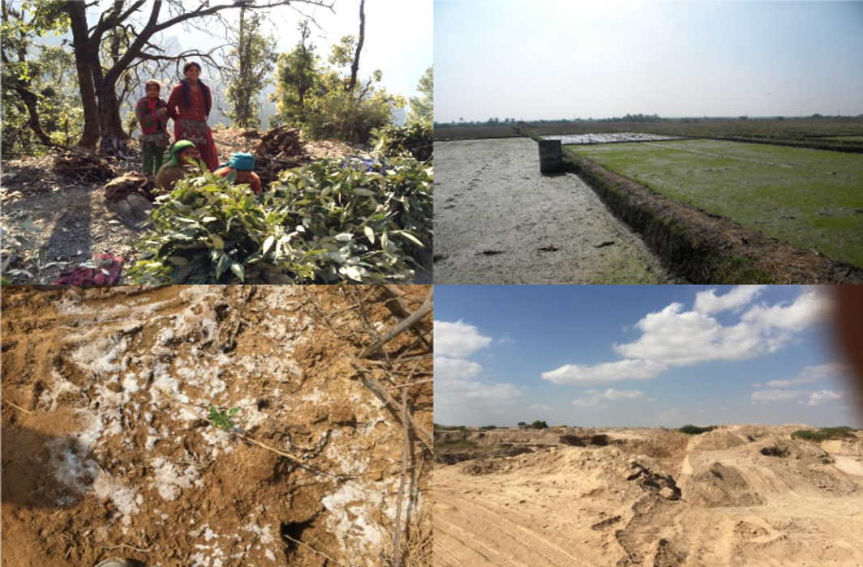
LAND DEGRADATION
Land degradation refers to a decline in the overall quality of soil, water, or vegetation condition commonly caused by human activities.
Causes of Land Degradation
Wrong Agricultural practices
Mining
Open Dumping
Deforestation and the removal of natural vegetation
Overgrazing
Urbanization
Pollution

Slide 27
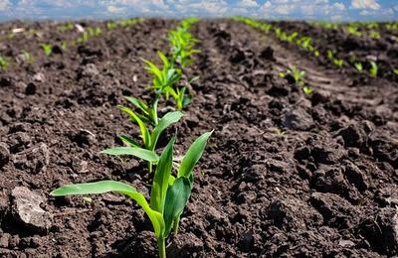
CONSERVATION OF LAND RESORCES
By educating, informing, and sensitizing people about various aspects of these precious resources and their sustainable use.
Under the afforestation and reforestation programs, planting trees, bushes, and grass help to check soil erosion.
Controlled mining and grazing activities.
Proper disposal of industrial effluents after treatment.
Regulated use of chemical pesticides and fertilizers.

Slide 28
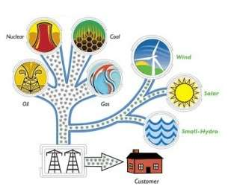
ENERGY RESOURCES
Energy is the capacity to do work and is required for life processes.
An energy resource is something that can produce heat, power life, move objects, or produce electricity.
Matter that stores energy is called a fuel.
Energy resources are essential for any society, be it one dependent on subsistence farming or an industrialized country.
Human energy consumption has grown steadily throughout human history.

Slide 29
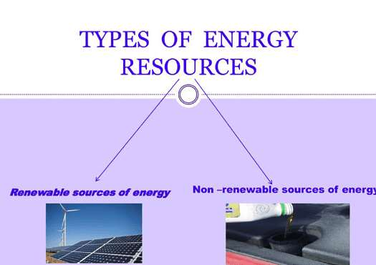
TYPES OF ENERGY RESOURCES

Slide 30
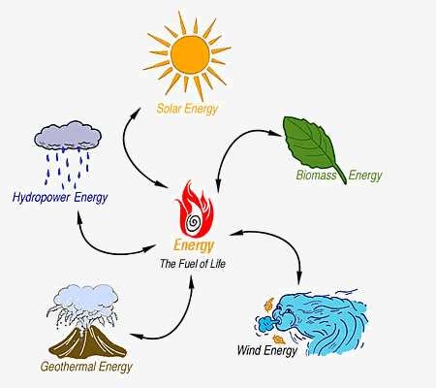
RENEWABLE SOURCES OF ENERGY
Renewable sources of energy can be used over and over again.
Renewable resources include solar energy, wind, geothermal energy, biomass, and hydropower.
They generate much less pollution, both in gathering and production, than nonrenewable sources.
Renewable energy resources will not run out because they can easily be regenerated.

Slide 31
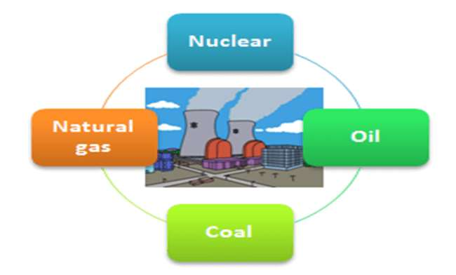
NON-RENEWABLE SOURCES OF ENERGY
Non-renewable resources of energy cannot be replenished in a short period of time.
Most non-renewable energy sources are fossil fuels: coal, petroleum, and natural gas.
Burning fossil fuels is harmful for the environment. When coal and oil are burned, they release particles that can pollute the air, water, and land.

Slide 32
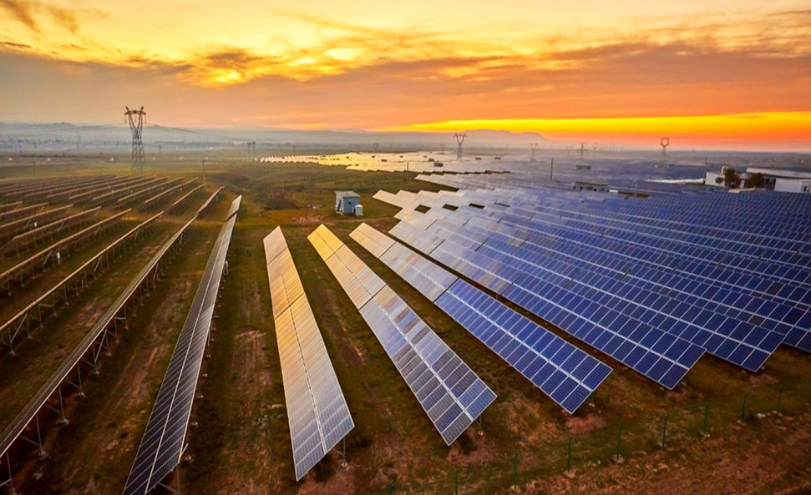
SOALR ENERGY
The primary source of energy
Results from nuclear fusion taking place in the central part of the sun
Methods to use solar energy
Thermal or Heating Method (Solar cookers, solar water heaters)
Photo-voltaic method (Solar cells)

Slide 33
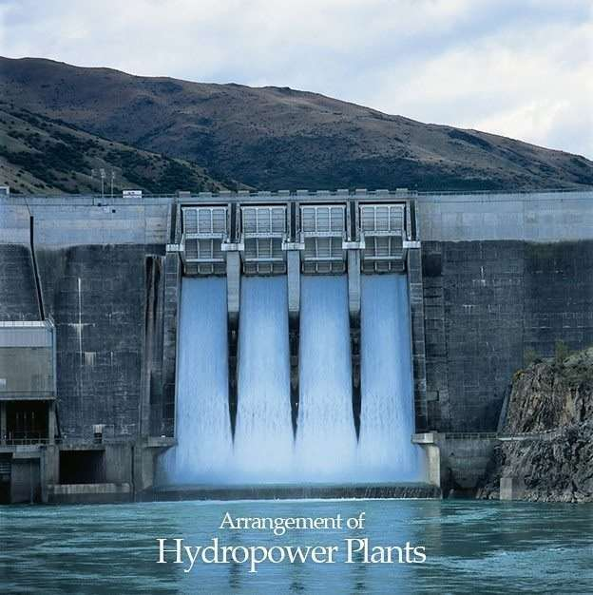
HYDROPOWER
The production of power through the use of the gravitational force of falling or flowing water. most widely used form of renewable energy.
Produces no direct waste, and has a considerably lower output level of the greenhouse gas, carbon dioxide, than fossil fuel-powered energy plants.

Slide 34
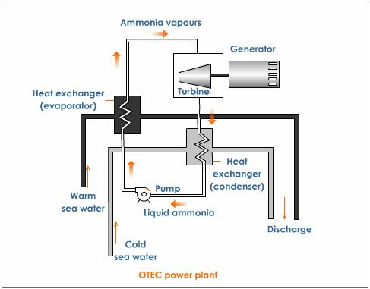
OCEAN THERMAL ENERGY
CONVERSION
The energy available due to the difference in temperature of water at the surface of the oceans and at the deeper levels is called Ocean Thermal Energy.
A difference of at least 20°C is required between the surface and deeper water of the ocean for operating OTEC (Ocean Thermal Energy Conversion) Power plants.

Slide 35
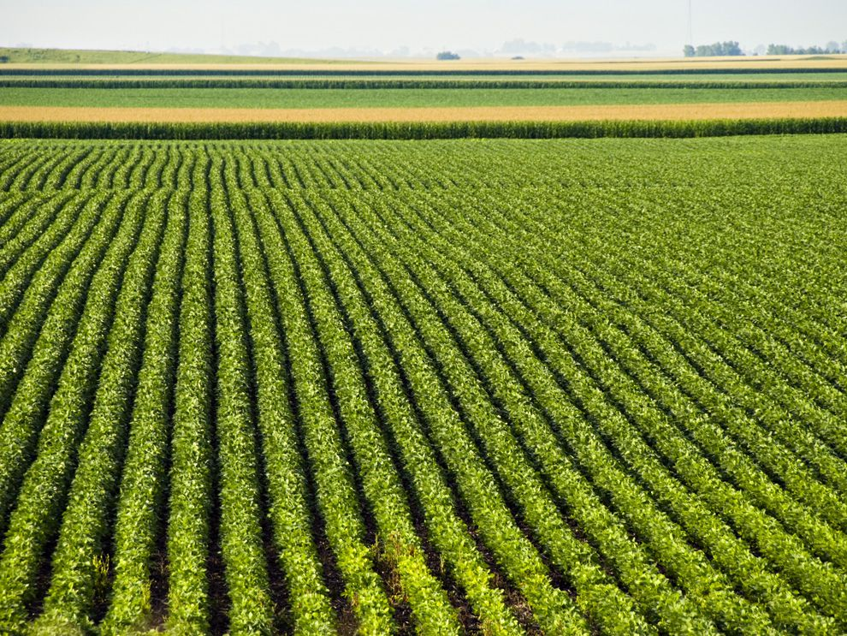
BIOMASS ENERGY
Biomass energy refers to renewable energy derived from organic materials, such as plants, agricultural and forestry residues, animal waste, and other organic matter.
These materials are collectively known as biomass and can be used as a sustainable energy source to generate heat, electricity, or even liquid biofuels.

Slide 36
BIOMASS ENERGY
Common types of biomass energy:
Biomass Power Plants: Biomass is burned in power plants to produce steam, which drives turbines and generates electricity. This process is similar to traditional coal or natural gas power plants but with a renewable fuel source.
Biofuels: Biomass can be converted into liquid biofuels, such as biodiesel or bioethanol. Biodiesel is typically made from vegetable oils or animal fats, while bioethanol is produced from crops like corn or sugarcane.
Biogas: Biogas is produced through the anaerobic digestion of organic materials, such as agricultural waste, food waste, or sewage. It consists mainly of methane and can be used for electricity generation or as a fuel for vehicles.
Biomass Heating: Biomass can be burned directly to provide heat for industrial processes, residential heating, or space heating in buildings.

Slide 37
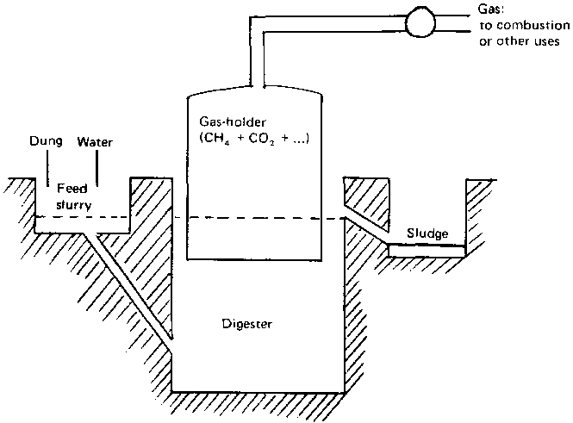
BIOGAS
.

Slide 38
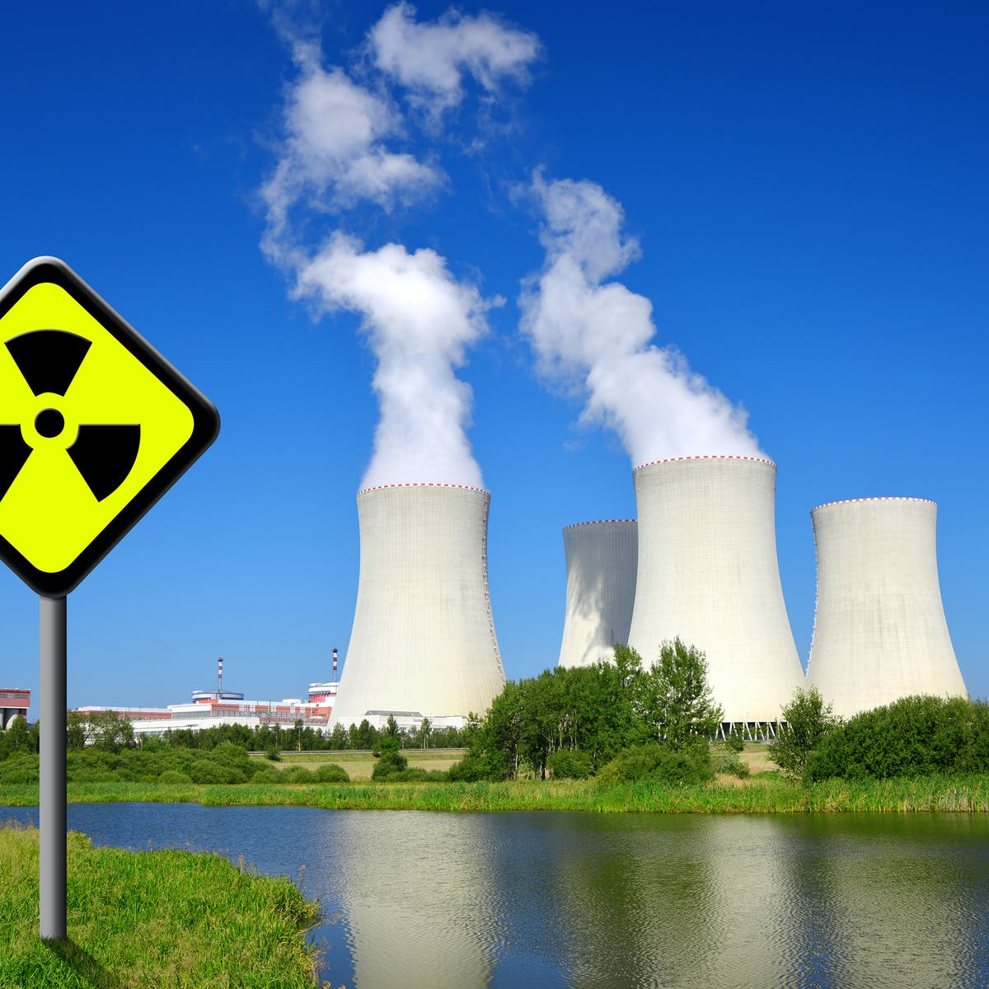
NUCLEAR ENERGY
Nuclear energy is energy in the nucleus (core) of an atom.
It can be released from atoms in two ways: nuclear fusion and nuclear fission.
In nuclear fission, atoms are split apart to form smaller atoms, releasing energy.
Nuclear power plants use nuclear fission to produce electricity.

Slide 39
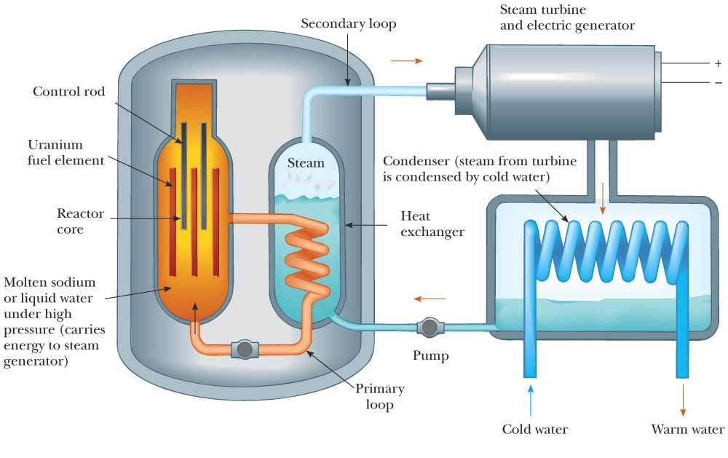
NUCLEAR ENERGY
Google images

Slide 40
NUCLEAR ENERGY
Advantages of Nuclear Energy
Low Greenhouse Gas Emissions: Nuclear power plants emit relatively low amounts of CO2 compared to fossil fuel power plants, contributing to climate change mitigation.
High Energy Density: Nuclear fuel provides a large amount of energy with a small amount of fuel, reducing transportation and storage requirements.
Reliable and Stable: Nuclear power plants can operate continuously for long periods, providing a stable and consistent electricity supply.
Challenges of Nuclear Energy
Nuclear Accidents: Although rare, nuclear accidents can have severe consequences for the environment and public health.
Radioactive Waste: The long-term management and disposal of nuclear waste require secure and safe solutions.
High Initial Costs: Building nuclear power plants can be expensive, and there are also costs associated with decommissioning plants at the end of their operational life.

Slide 41
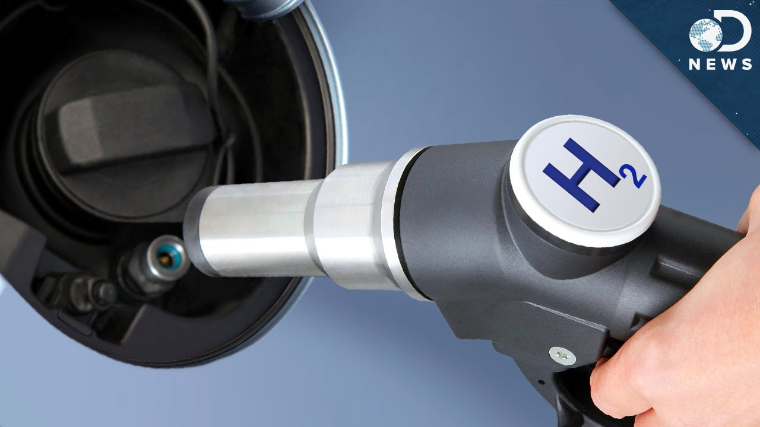
HYDROGEN AS A FUEL
As hydrogen burns in air, it combines with oxygen to form water, and a large amount of energy is released.
Due to its high, rather highest calorific value, hydrogen can serve as an excellent fuel.
It is non-polluting and can easily be produced. However, hydrogen is explosive in nature.
Hence safe handling is required for using hydrogen as fuel. Also, it is difficult to store and transport.

Slide 42
HYDROGEN AS A FUEL
Advantages of Hydrogen as a Fuel:
Clean Energy Carrier: When produced using renewable energy sources, hydrogen is a clean and sustainable energy carrier that does not produce greenhouse gas emissions during use.
Versatility: Hydrogen can be used in various applications, including transportation, stationary power generation, and energy storage, making it a versatile energy solution.
High Energy Density: Hydrogen has a high energy content by weight, which makes it attractive for certain applications, particularly those requiring high energy density.
Challenges of Hydrogen as a Fuel:
Production and Distribution: Hydrogen production can be energy-intensive, and establishing a widespread hydrogen distribution infrastructure can be costly and challenging.
Storage: Hydrogen has a low energy density by volume, requiring special storage solutions to make it practical for certain applications.
Safety: Hydrogen is highly flammable and requires careful handling and safety measures.

Slide 43

CONSERVATION OF NATURAL RESOURCES
Instead of deforestation, reforestation should keep in mind.
We must develop energy-saving methods to avoid waste of energy.
Use drip irrigation and sprinkling irrigation to improve irrigation efficiency.
Utilize renewable energy sources as much as possible. Encourage the use of solar cookers etc.
Install rainwater harvesting system in houses, and colonies.
Try to educate local people about the protection and judicious use of natural resources.

